Slide 1
SoulPactum
Create by: Pisti Demeter, Norbert Sándor, Patrik Dávid Szivós

Slide 2
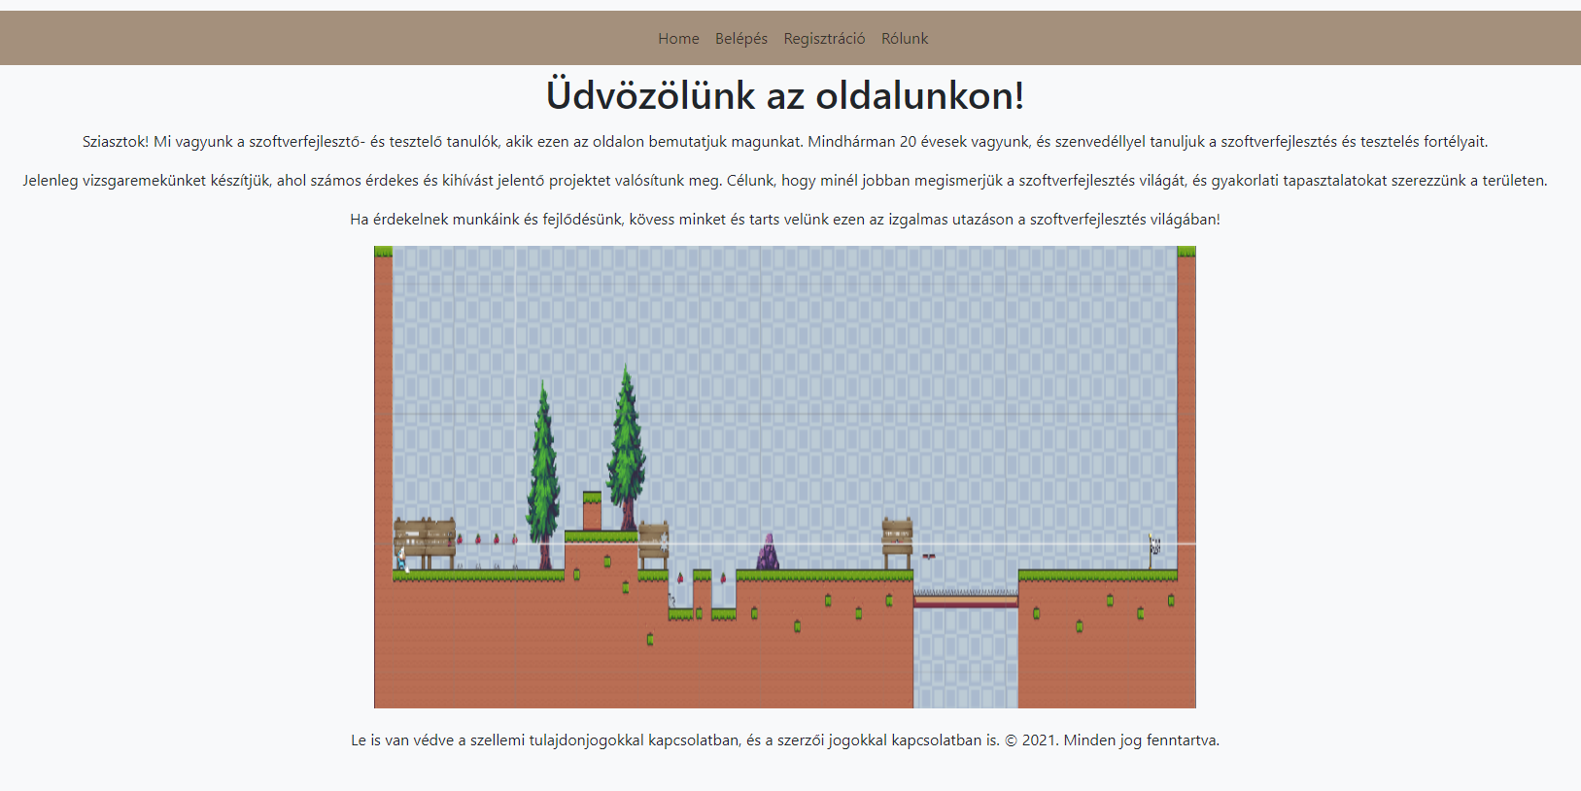
Homepage
It contains 4 buttons:
Home
Login
Registration
About us

Slide 3
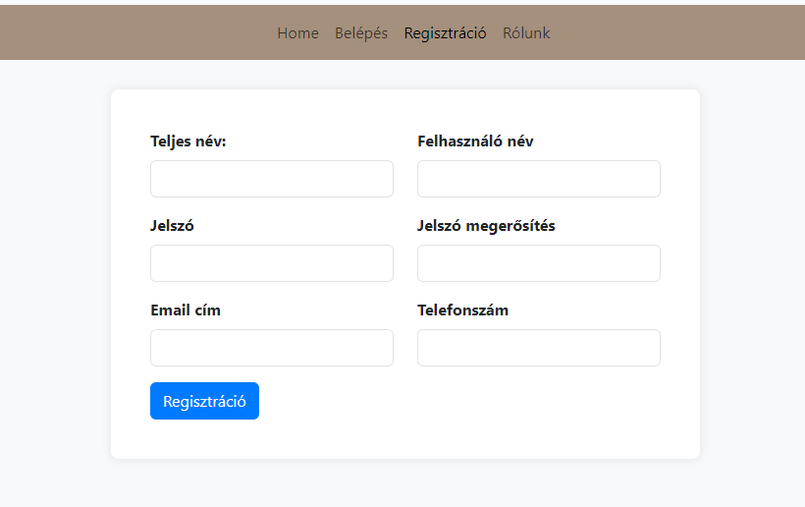
Registration
In order to register some information is nessesary:
Username
Full name
Emai address
Phone number
Password

Slide 4
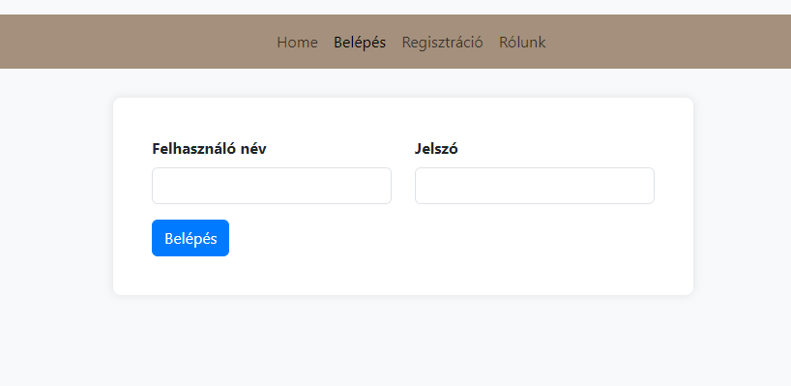
Login
If you want to log in, you have to write your:
Username
Password

Slide 5
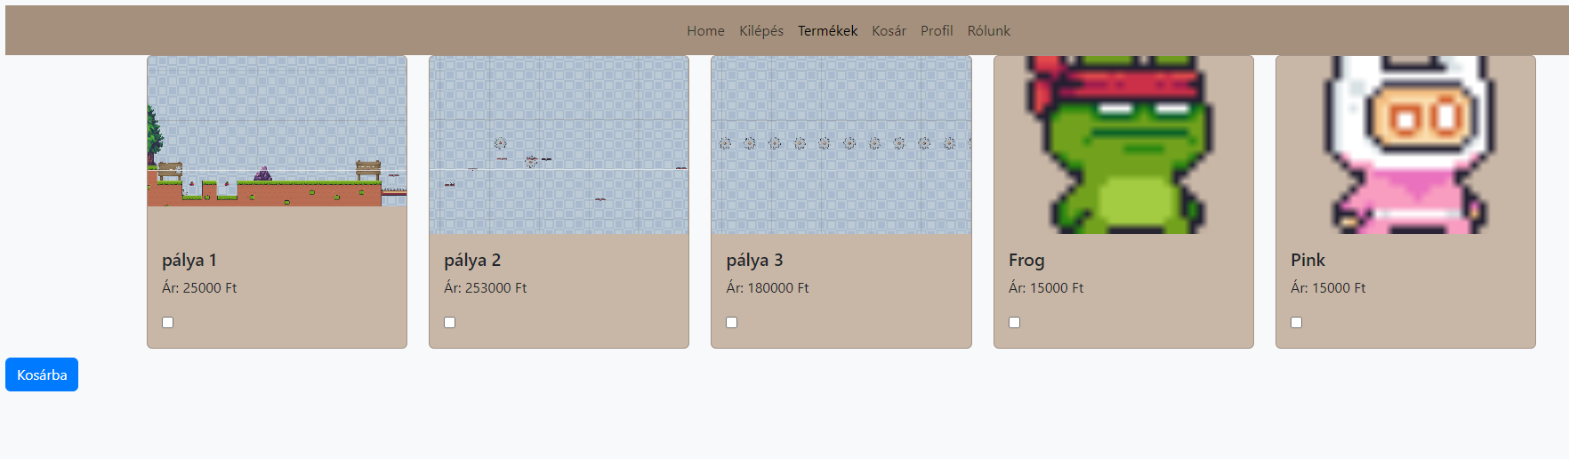
Products
This page contains our products
You can choose from the different fields and some characters and you can add then to the cart.

Slide 6
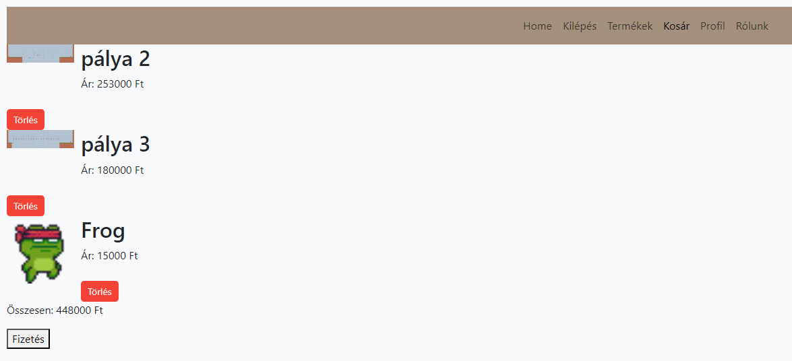
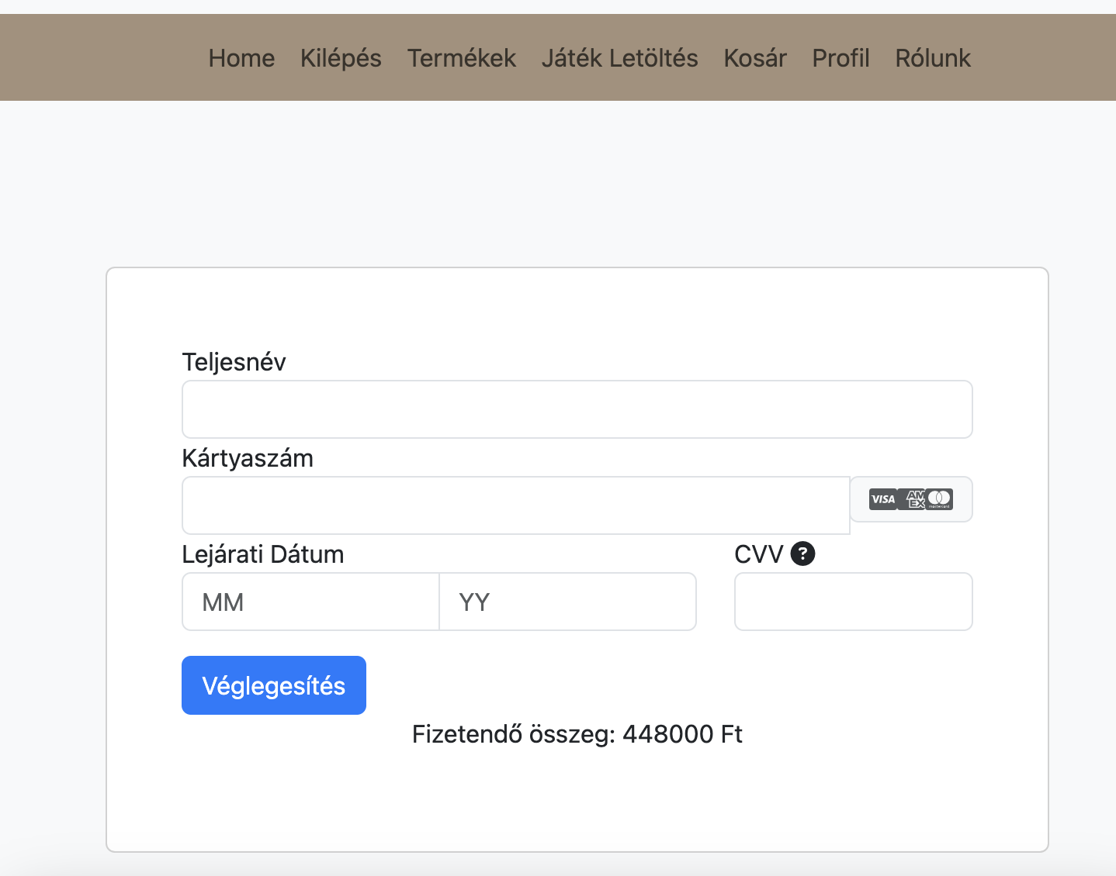
Cart
It list all the products you want to buy and their prices
If you click on the Pay/Fizetés button you are directed to the page where you have to give your credit ard details

Slide 7
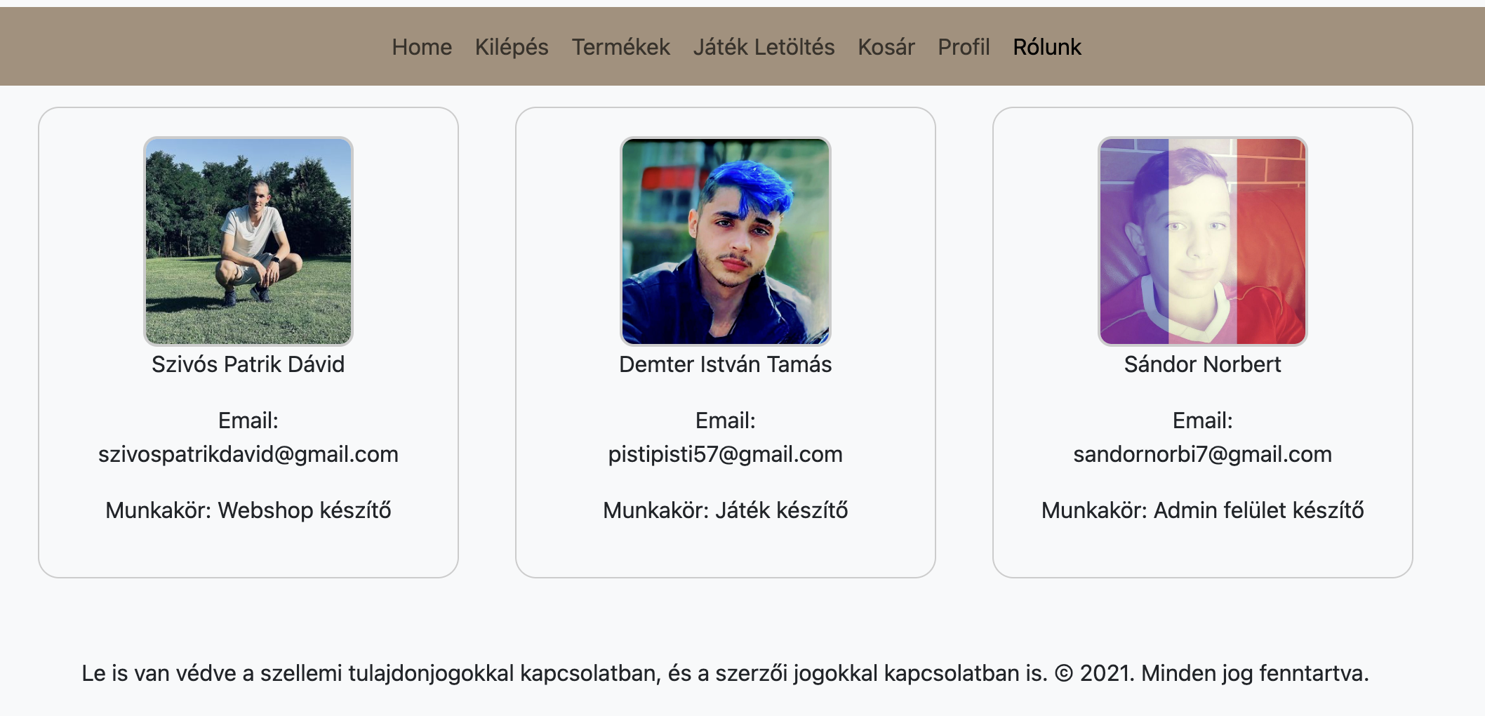
About us

Slide 8
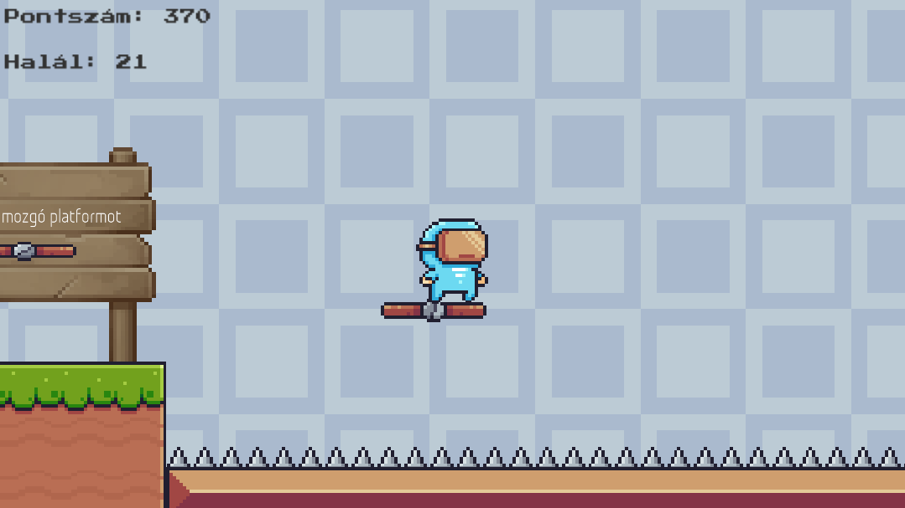
The game
Engine
The type of game
Target audience
Our goal

Slide 9
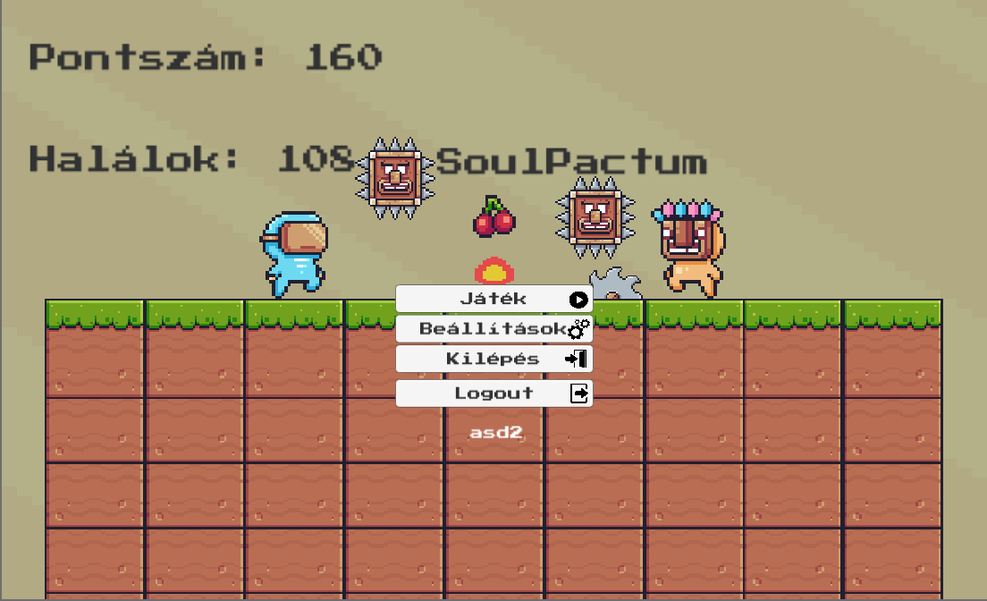
Main menu
Player informations
Game name
Player name

Slide 10
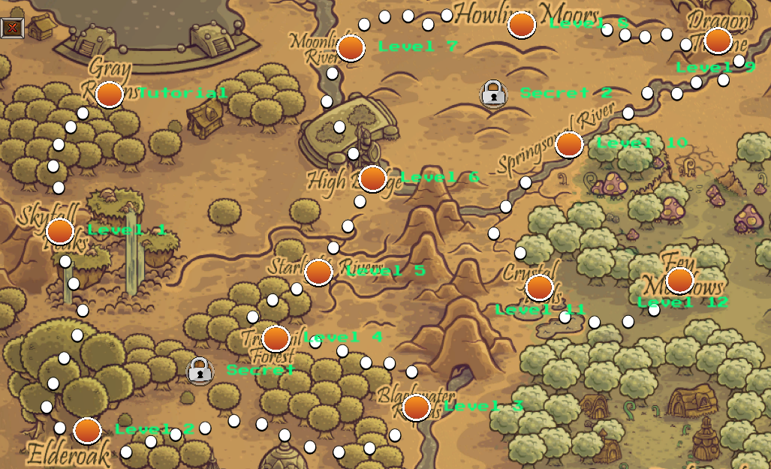
Map
More levels coming soon
Secrets
Plans

Slide 11
Implementation
Programing languages:
Why? Because…
C#
PHP
phpMyAdmin
Challenge
Experience
Preferred

Slide 12
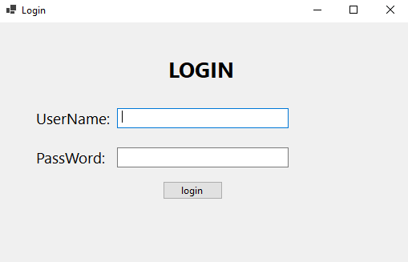
Login
You can log in to the admin interface here
You must enter a username and password

Slide 13
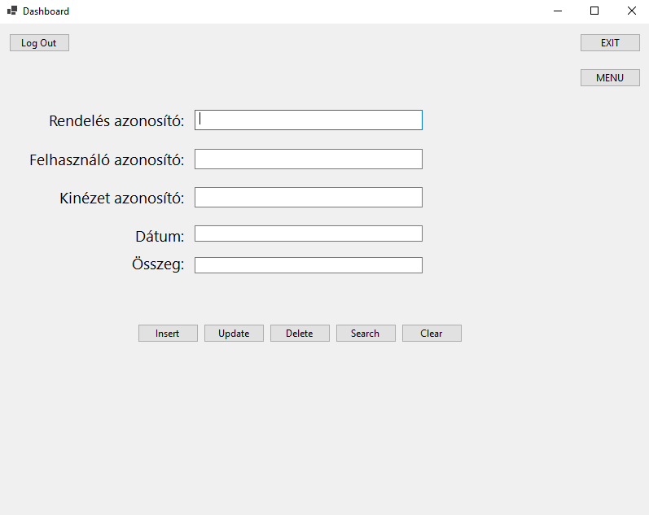
Order
After logging successfully, the admin sees this page. It contains some information about an order.

Slide 14
Thank you so much!

